Slide 1
Kensington E-Lock
David Garrambone, Eli Wissenbach, Hannah Srock and Brian Soriano
Notes:
Hannah

Slide 2
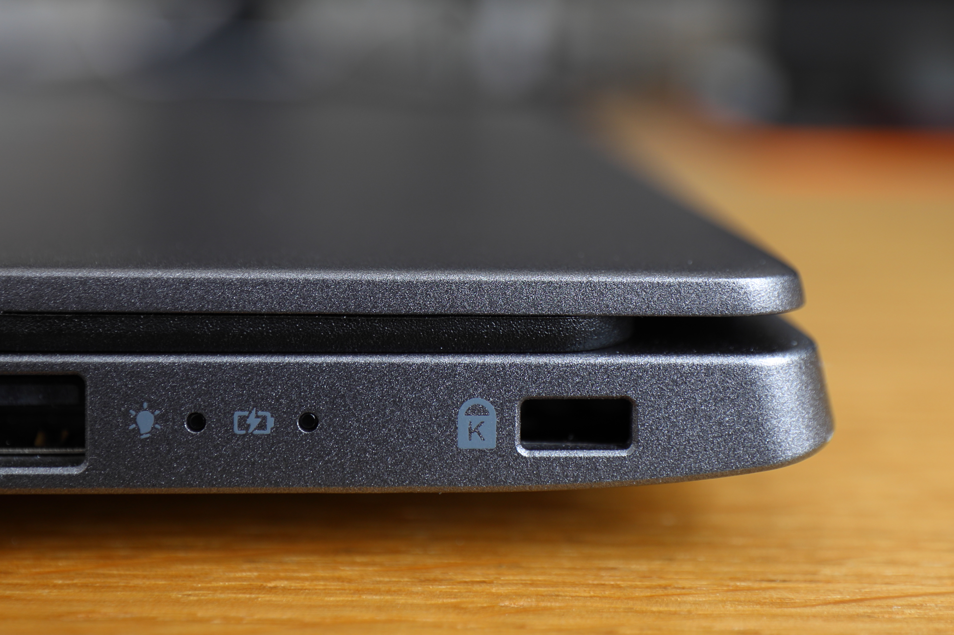
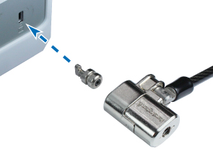
Project Background
Kensington is currently the world leader in electronic security products
How the Kensington Lock works
Traditionally Kensington computer locks have used a cable to keep laptops secure
Kensington would like to modernize this design and to make the cable optional
Issues with cable: bulky, easily defeated, outdated
Notes:
hannah

Slide 3
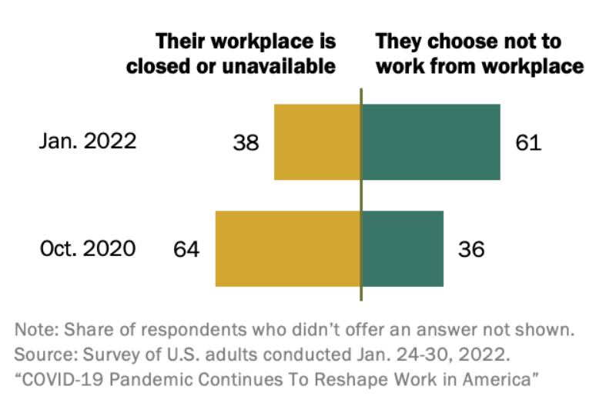
Market Analysis
Kensington controls 70% of the computer security market
99% of business laptops have a Kensington Security Slot
Common customers include students, business professionals, IT departments within large businesses
60% of US workforce is work from home
Add Picture
Notes:
eli

Slide 4
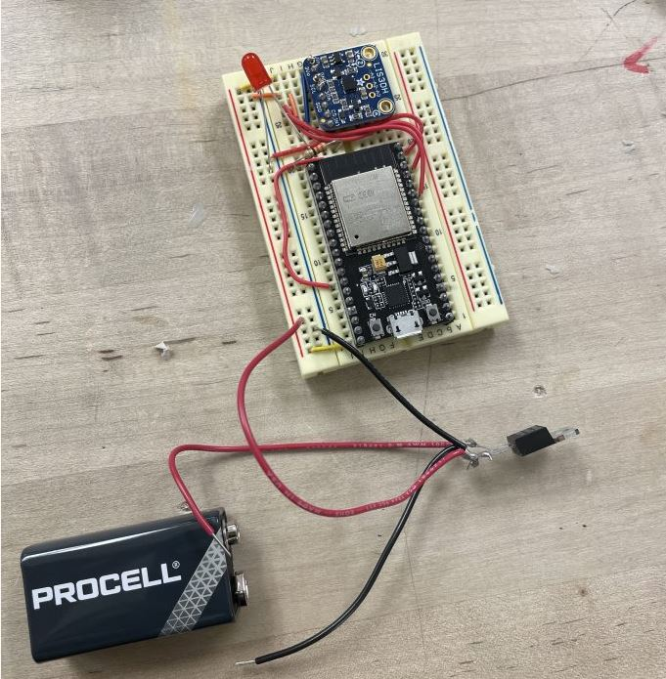
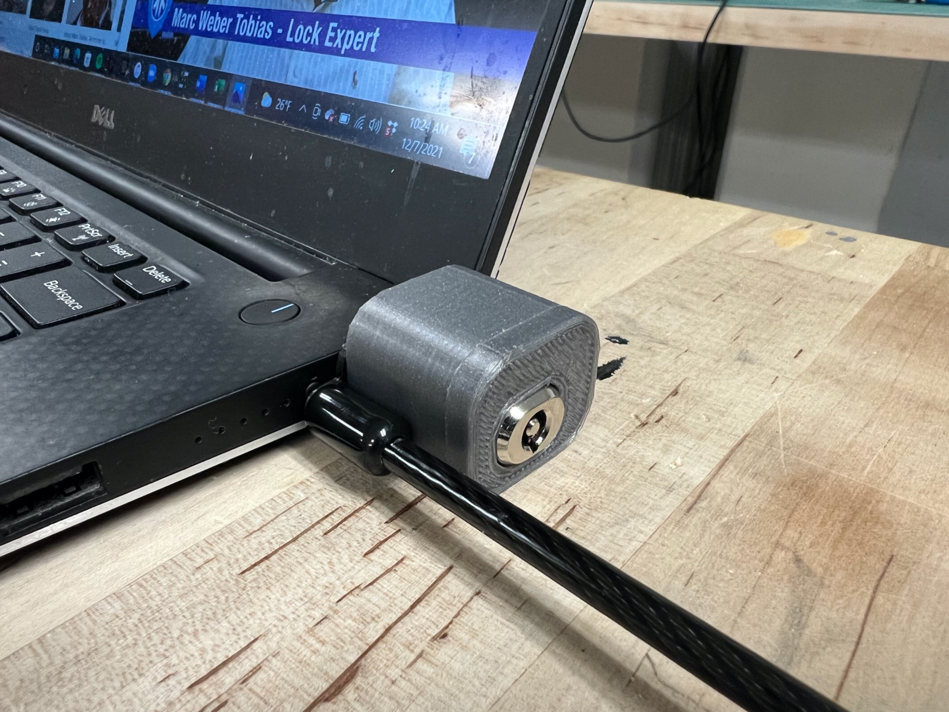
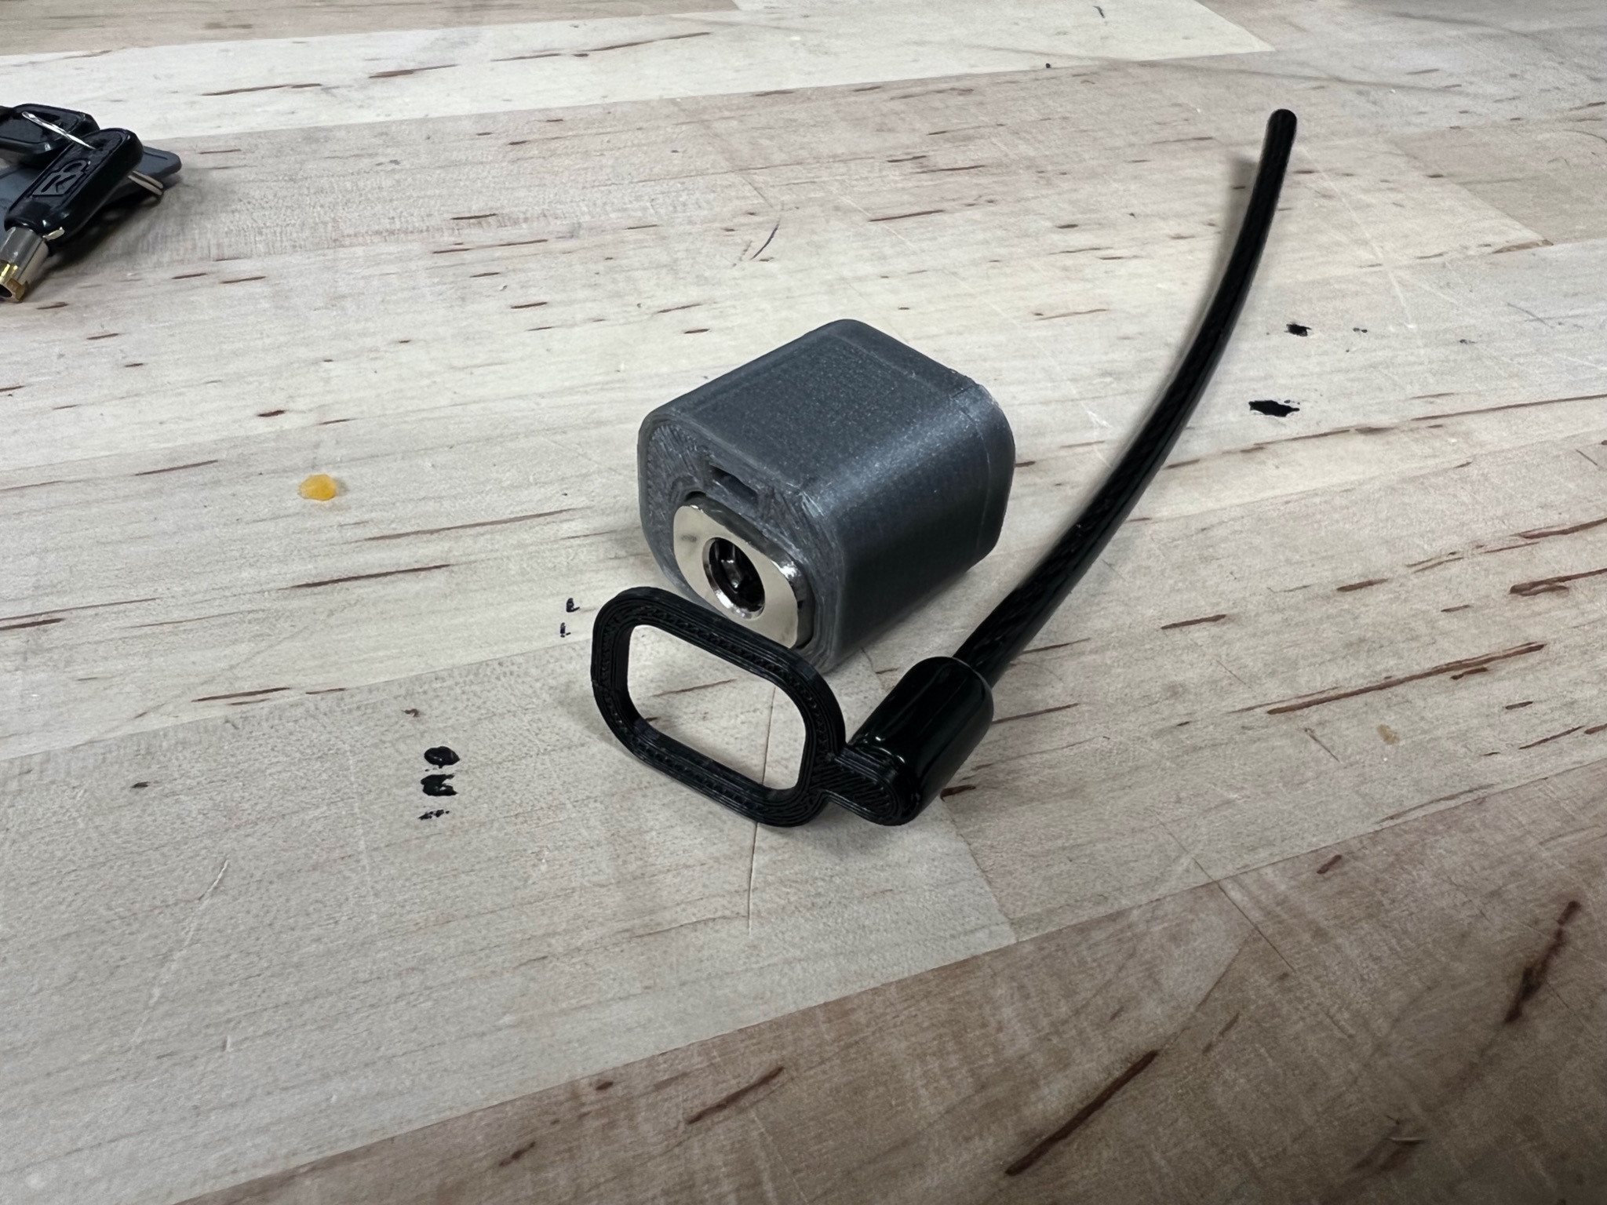
History of Prior Work
Previous group produced a minimally sized housing for the lock as well as working electronic components
Cable easily removed yet still sturdy
Components could not fit in the housing and were not able to connect to all devices via Bluetooth.
Housing was a prototype 3D print, not sturdy enough for production
Limited battery life
9V not Rechargeable
Charging port creates weak point
6.5 hours
Notes:
Eli 17-34 hours now ideally 28-57 hours

Slide 5
Problem Statement
The goal of our project is to improve the current Kensington Lock design
Create an electronic lock with removable cable
Customer requirements
Alert user of theft
Small, compact design
Compatible with Kensington lock system
Minimize size of electronic components
Improve battery life and include rechargeable battery
Secure housing
Detachable cord for extra protection
Notes:
hannah

Slide 6
Approach to Solution
Decided to build on the last groups design
Was small, compact, and gave a good launching off point
Realized we don’t have the knowledge, experience, or tools to create custom electronics small enough for housing
Created idealized housing and left electronics separate
Decided to redo the electronics and solder a circuit with a lower energy requirement
Iterated with different boards and bluetooth apps
Slightly expanded housing to accommodate deadman switch
Notes:
brian

Slide 7
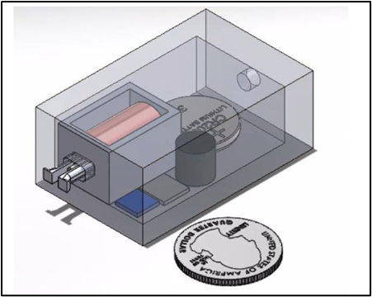
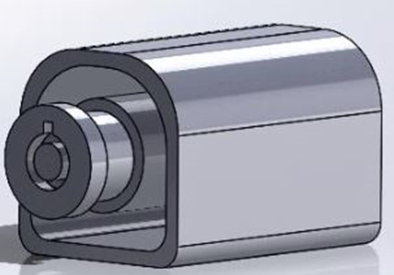
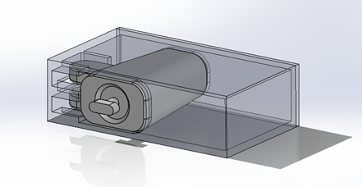
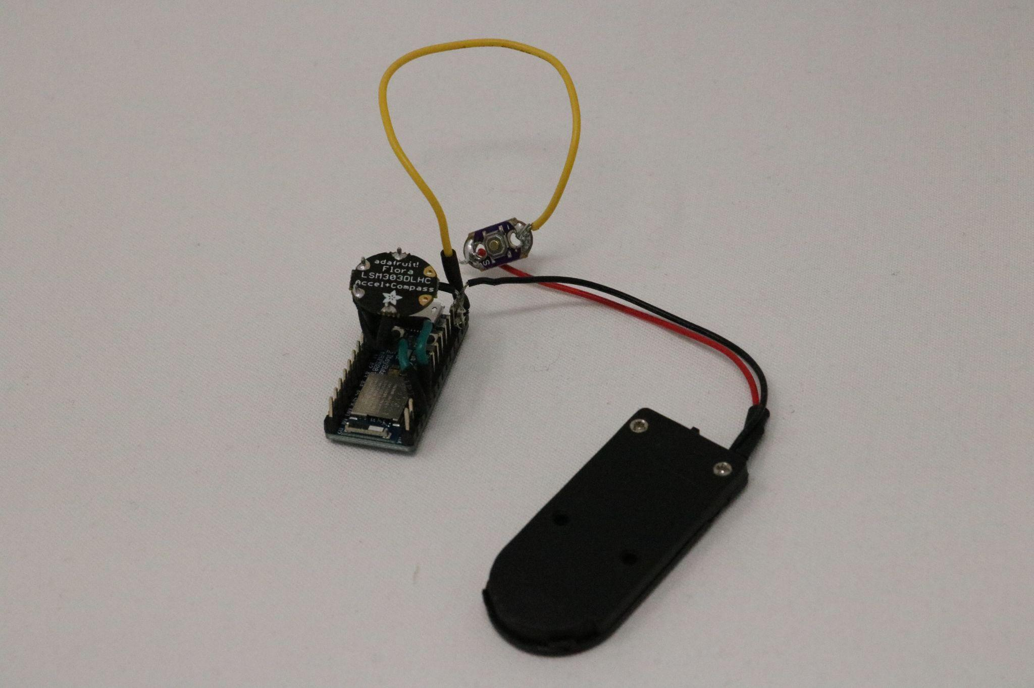
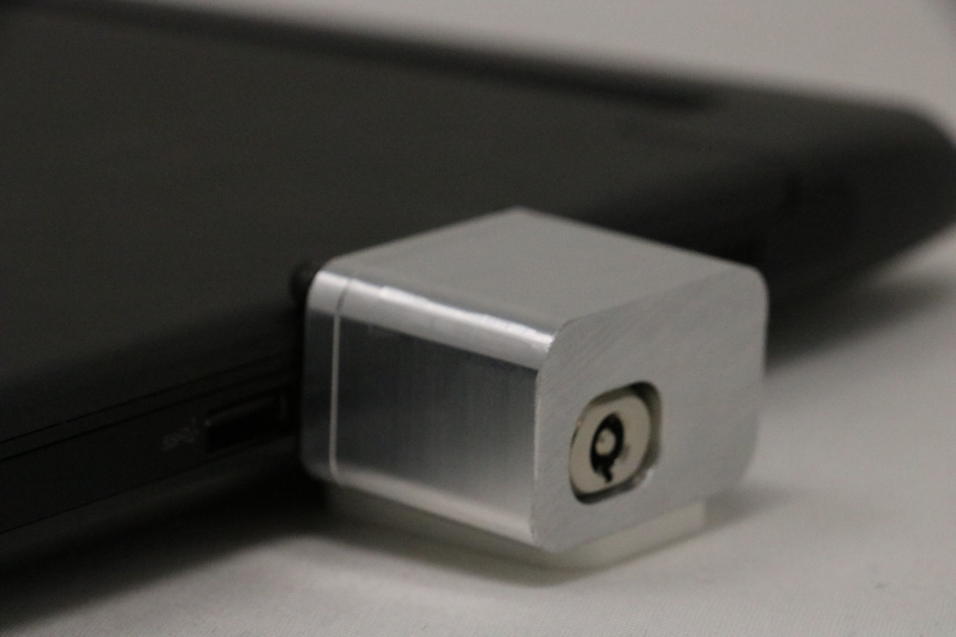
Third iteration adds room for electronics
First iteration with solenoid lock
Second iteration wrapping around lock core
Fifth iteration expands for deadman switch
Fourth iteration minimizes housing
Design Evolution
Notes:
brian

Slide 8
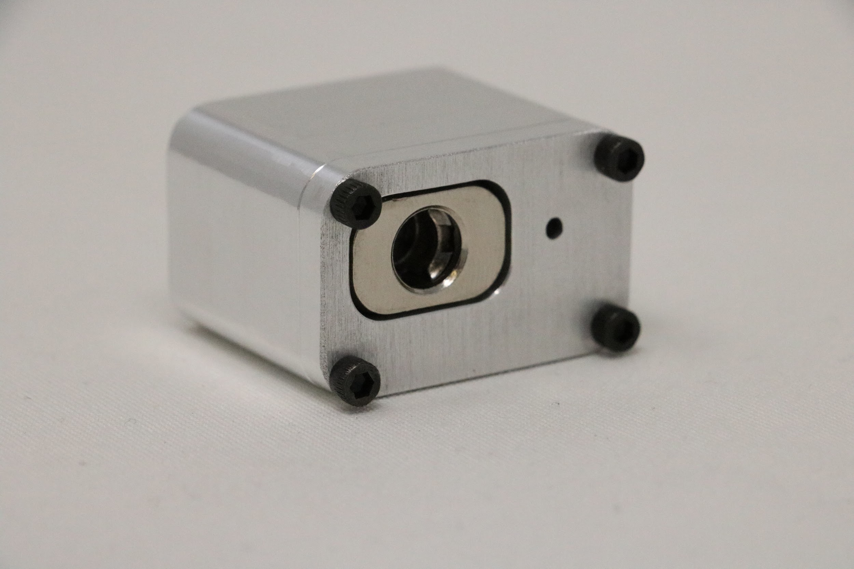
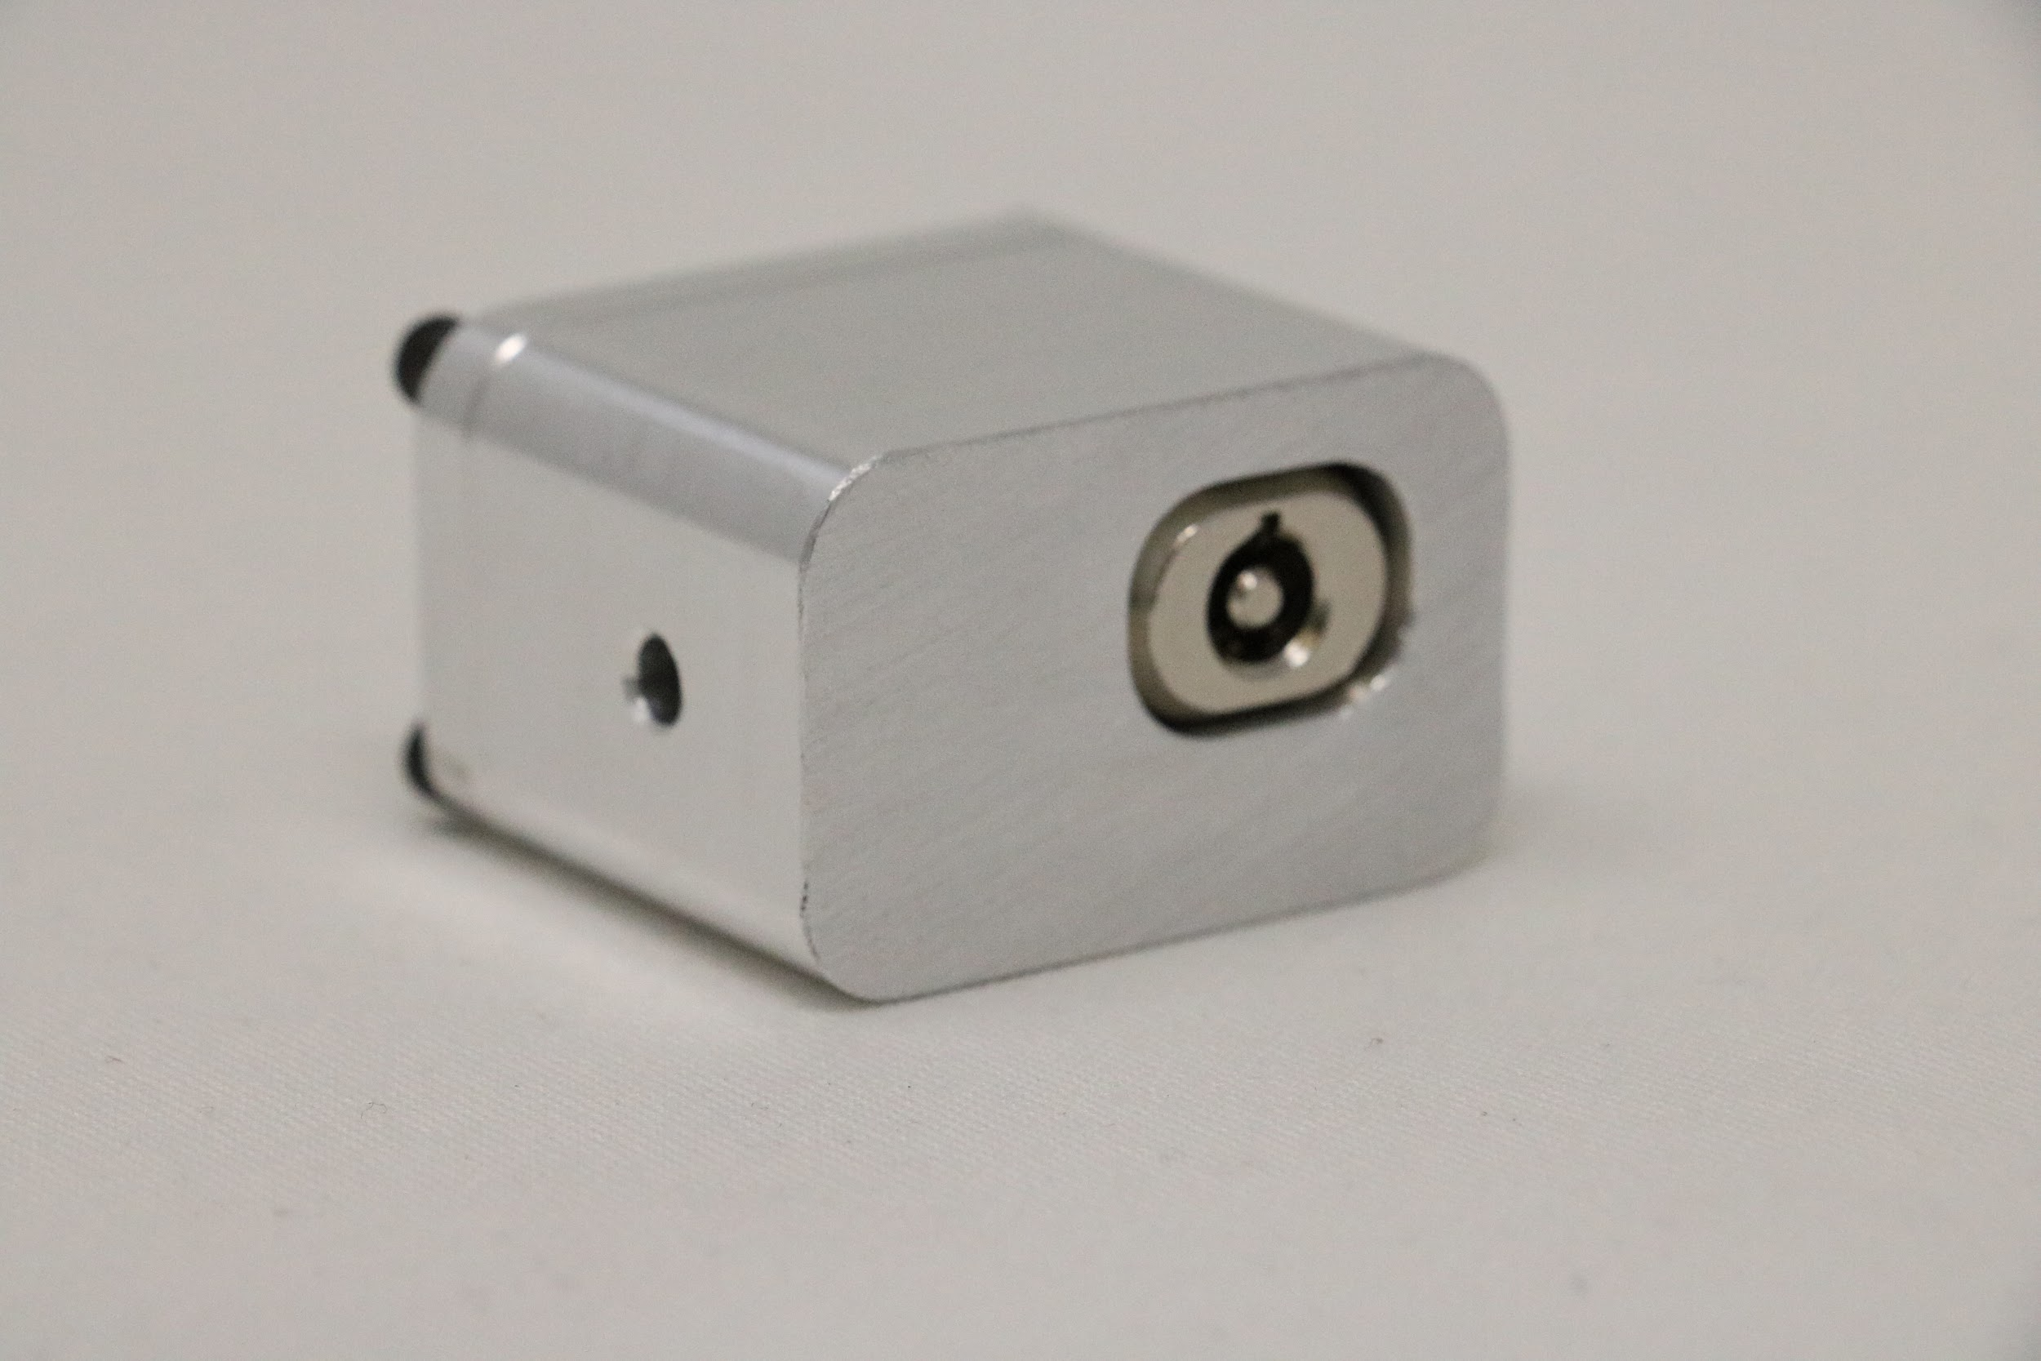
Final Design
Housing:
Final design is a 27 x 27 x 37 mm aluminum box with holes for the deadman switch, and wireless charging
Screws and deadman switch face the computer, eliminating the possibility of being undone while in use.
Separate electronics send user mobile alerts when motion is detected
Electronics:
ItsyBitsy nRF52840
Flora Accelerometer
Coin cell batteries
Button
Wireless charging coil (not wired into main circuit)
Transfers voltage to charge the battery when both coils are brought near each other
Notes:
brian

Slide 9

Results
Successfully able to detect movement of laptop
Successfully able to send notification to users phone
Eliminated “easy access points”
Wireless charging does not yet transfer full voltage
Gives 2.5 volts needs to be 5 volts
Can achieve by winding coil tighter and adding more loops
Created Idealized metal housing
Notes:
David
In terms of our results, we are very proud of what we were able to accomplish functionality wise. Our final system is able to detect motion through the accelerometer, and send a notification to a user’s phone. You guys can see this being displayed in this video on the left. The app shown displays the word “shaking” every time the E-lock is moved. In addition, we also removed all easy access points from the housing. With the charging port removed, our housing is essentially closed on all six sides, which improves security and makes tampering very difficult. On top of that, we were able to successfully assemble a working wireless charging circuit. It does not yet transfer the full voltage, meaning when 5 volts was applied to the transmitter circuit, the receiver circuit only read 2.5 volts when the coils were brought close to each other. However, this can be easily fixed by tightening and aligning the coils better, and increasing the amount of turns of the wire. Lastly, through SCPI, we were able to create our idealized metal housing out of aluminum, which is a much stronger and safer material than the previous 3D extruded filament.

Slide 10
Notes:
David
Here you can see the video of the wireless charging circuit transferring power. The transmitter circuit is the one on the left and the receiver right. The transmitter circuit has 5V being applied to it, and when the coils are brought close together, the transmitter circuit induces a current in the receiver circuit through magnetic flux, generating a voltage in the receiver circuit that you can read on the multimeter as 2.5V

Slide 11
Recommendations for Future Work
Miniaturized electronics to fit inside idealized housing
Laptop speakers or E-Lock speakers
Cover wireless charging port with woven fiberglass
Can withstand bludgeoning, most chemical solvents, and has a high melting point
Can also look into Teflon or Plexiglass (PMMA)
Kensington E-Lock specific app
Notes:
There are numerous ways to build upon the functionality of our project. Some recommendations we have for future work are as follows:
Achieving a much smaller size circuit that can fit into the small lock housing so the entire product is simply the housing and a no-contact charger
Another option that would be advantageous to users of the E-Lock would be the usage of audio. This can either be through a small speaker that also fits in the housing, or a system that utilizes the actual laptop speakers to emit a louder signal upon movement.
As our project currently stands, we have a hole in one side of our main housing in order to allow for wireless charging. In the future, this hole needs to be sealed in order to avoid tampering with the electronics. Ideally, it should be sealed with a material that can conduct magnetic flux well, but is still very strong such as fiberglass. This would be to allow for good functionality of wireless charging, while still maintaining protection of the electronics.
Lastly, a great idea for users to receive notifications from the accelerometer and perhaps even track their E-Lock device using tracking technology would be the creation of an E-Lock specific app.

Slide 12
Acknowledgements
Dr. Eric Winter
Dr. Marc Tobias
SCPI
SERC
Notes:
We would like to thank both Dr. Winter and Dr. Tobias for their assistance and guidance throughout the semester, and would also like to give thanks to the Swanson Center for Product Innovation, and the Student Electronics Resource Center for providing us with the machines and circuit components needed to construct our project. Thank you guys all so much for listening. Any questions?

Slide 13
Problem Statement
Project background
Any info on market
opportunity, etc.
History of prior work
Customer requirements
Proposed Solution
Solution approach
Examples of design
evolution
Prototype(s) created
Final design
Results
Verification / validation
conducted
Comparison to targets
requirements
Conclusions
Determination of success
/ failure
Recommendations for
future work
Acknowledgements

